Slide 1

ISDT CA2
Member(s):
Tenia Xu Yuan (P1935334)
Sebastian Pang (P1935631)

Slide 2
Game Name
Construction Site Safety Game

Slide 3
Theme
Simulation:
A simulation video game describes a diverse super-category of video games, generally designed to closely simulate real world activities. A simulation game attempts to copy various activities from real life in the form of a game for various purposes such as training, analysis, or prediction.

Slide 4
Background Information
The construction industry is known for being one of the most dangerous fields to work in. Out of every 5,000 private-industry worker fatalities, 20 percent are in construction. That means one out of every five worker deaths is construction-related!

Slide 5

Background Information

Slide 6

Background Information

Slide 7
Summary of Game
There are total of 3 different safety procedure. Players have to move around the map to locate the procedures and learn the correct method to prevent possible accidents from occurring.

Slide 8
Purpose of Game
Educate people on how to protect themselves and others on a construction site.

Slide 9
Target Audience
Preferably construction workers but may also apply to the public to gain more knowledge.

Slide 10

Controllers
Oculus Rift
Headset + 2 Controllers (L/R hand)

Slide 11
Safety Procedures
Safety Gear
Fire Safety
Gas Leak

Slide 12
Difficulty Level
Level 1: Safety Gear
Level 2: Fire Safety
Level 3: Gas Leak
Notes:
<Describe using walkie talkie>

Slide 13
Safety Procedure #1 – Safety Gear
Protection
Lessen likelihood of injury
Reduce exposure to hazards

Slide 14

Safety Procedure #1 – Safety Gear

Slide 15
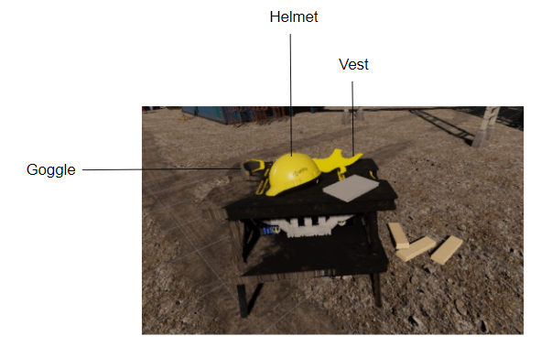
Safety Procedure #1 – Safety Gear

Slide 16
Safety Procedure #2 – Fire Safety
Preventing fire from occurring
Prevent explosion
Keep workers safe from a fire
Reduce damages
Save lives

Slide 17
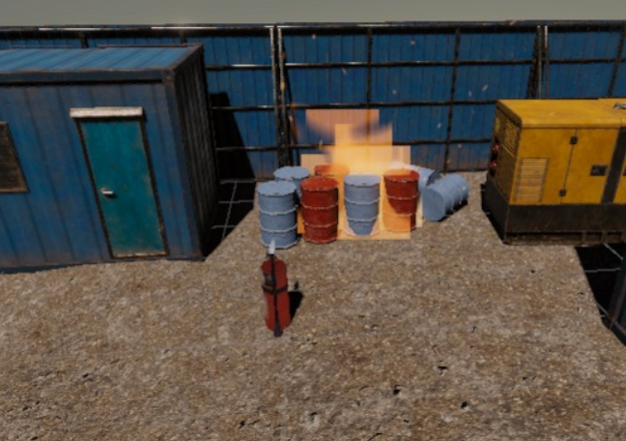
Safety Procedure #2 – Fire Safety

Slide 18
Safety Procedure #3 – Gas Leak
Prevent explosion
Keep workers safe from possible harmful gas
Save lives

Slide 19
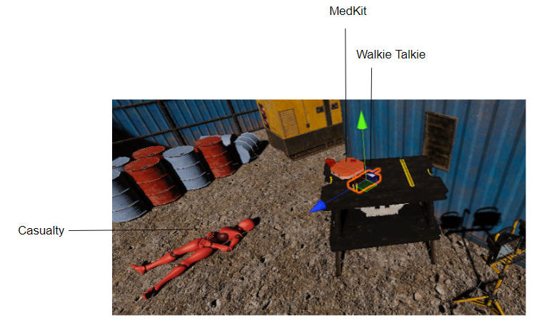
Safety Procedure #3 – Gas Leak

Slide 20
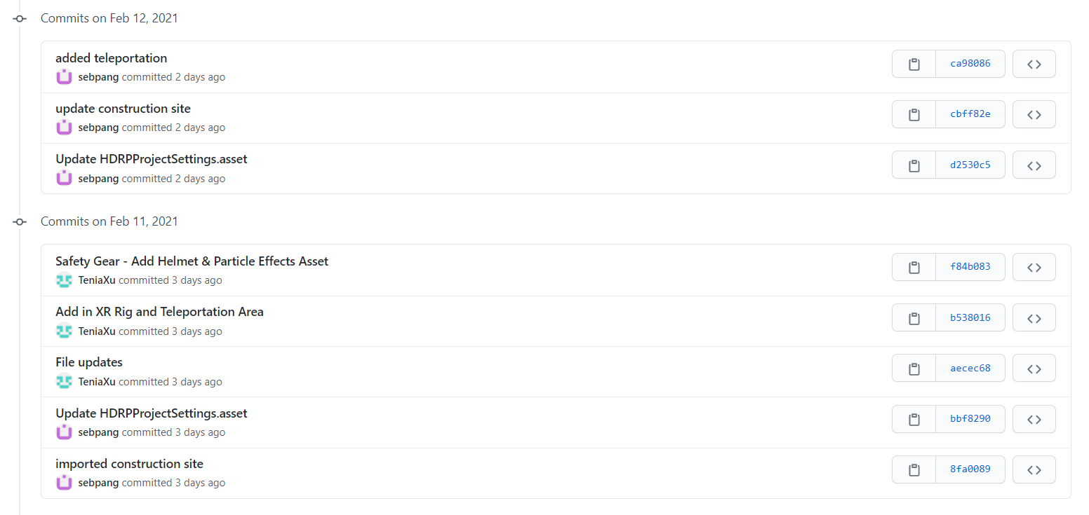
Version Control Usage
Notes:
<Describe using walkie talkie>

Slide 21
Static, Dynamic Batching and GPU Instancing
Notes:
<Describe using walkie talkie>

Slide 22
Code Indentations
Notes:
<Describe using walkie talkie>

Slide 23
Excel
Notes:
<Describe using walkie talkie>

Slide 24
JSON
Notes:
<Describe using walkie talkie>

Slide 25

End of slides ☺

